Slide 1
Comparing models

Slide 3
Is there a banana in my exhaust pipe?
With a banana in an exhaust pipe, most cars won’t start (95%)
But bananas in exhaust pipes are quite rare.
My car won’t start.
What is the chance there is a banana in my exhaust pipe?
Notice that:
p(nostart|banana) is not the same as
p(banana|nostart)

Slide 4
p values
p(data | null=True) p(nostart | nobanana)
Not
p(null | data) p(nobanana | nostart)
And definitely not
p(H1 | data) p(banana | nostart)

Slide 5
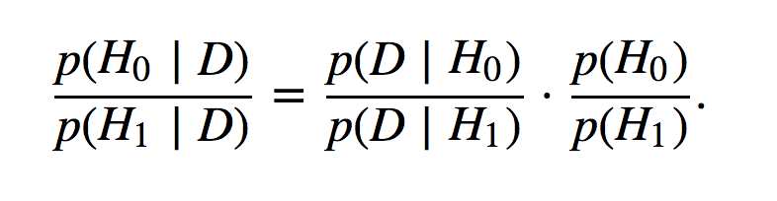

Slide 7
My child is scratching her head! Does she have nits?
Evidence: We see scratching!!!
If kids scratch their head, what percentage have nits?
10%? (Odds = 9 to 1 against or .111 for)
Prior: How common are nits?
5%? (Odds = 19 to 1 against or .053 for)
How do the odds change if we see scratching?
Odds = 19/9 = 2.1 times greater, compared with prior
p(nits|scratch) = 1 – (2.1 / (1+2.1)) = 32%

Slide 8
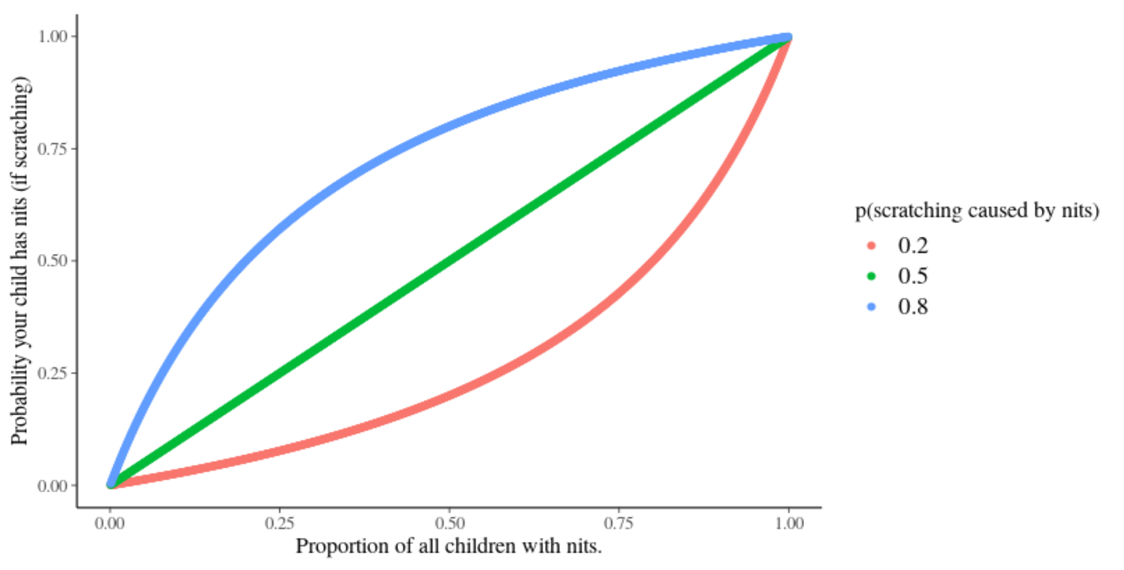

Slide 9
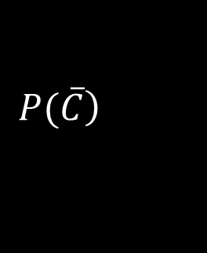
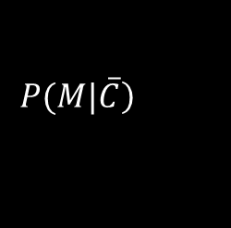
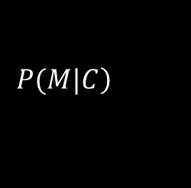
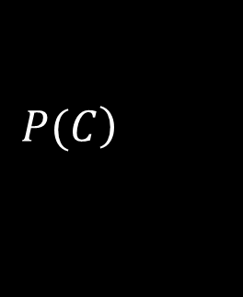
Bayesian Literacy
1000 kids
10%
90%
$$\left.P(C\right)$$
$$\left.P(\overline{C}\right)$$
50 with nits
950 without nits
90%
10%
4%
5 scratching
855
$$\left.P(M|C\right)$$
$$\left.P(M|\overline{C}\right)$$
9 / (9 + 40) = 18.52%
Many physician commit the so called “base rate fallacy” (neglecting the a priori probability).
See, for example, Bramwell R, West H, Salmon P. (2006). Health professionals’ and users’ interpretation of screening test results: an experimental study. British Medical Journal. 333, 284-286.

Slide 11
If shown stereotyped words relating to age, will I walk slower?
Read a few sentences with stereotyped words then measure walking speed.
t test = p(data|null) = .049
What should we think?
How likely is this really? p(null) = 95%?
https://scholar.google.com/scholar?q=Automaticity+of+social+behavior%3A+Direct+effects+of+trait+construct+and+stereotype+activation+on+action+Bargh+1996

Slide 12
Posterior odds = prior odds * “observed odds” (likelihood)
Chance it’s a “real effect” = How likely it is * How much evidence we have
Prior
Let’s agree we said the chance this is “real” is 10% (quite implausible)
Prior odds = (1 - .1) / 0.1 = 9
We think it’s 9 times more likely to be false than true
Evidence
p = .049
“Observed odds” = (1 - 0.049) / 0.049 = 19.4
19.4 times more likely that we see these data if H0 is False
What to think now
After seeing the evidence, it’s 19/9 = 2.1 times more likely to be “real”, than not.
p(real) = 2.1 / (1+2.1) = 68%

Slide 13
Alternative Prior
Imagine we said this is very implausible …. Perhaps 5%
Prior odds = (1 - .05) / 0.05 = 19
We think it’s 19 times more likely to be false than true
Evidence/Likelihood
p = .049
“Observed odds” = (1 - 0.049) / 0.049 = 19.4
19.4 times more likely that we see these data if H0 is False
What we should think…
After seeing the evidence, it’s 19.4/19 = 1.02 times more likely to be “real”, than not.
p(real) = 1.02 / (1+1.02) = 51%

Slide 14
* I really don’t think it is!
Prior
If we said this is actually quite likely*…. Perhaps 50%
Prior odds = (1 - .5) / 0.5 = 1
We think it’s equally likely to be real as false
Evidence/Likelihood
p = .049
“Observed odds” = (1 - 0.049) / 0.049 = 19.4
19.4 times more likely that we see these data if H0 is False
What to think now…
After seeing the evidence, it’s 19.4/1 = 19.4 times more likely to be “real”, than not.
p(real) = 19.4 / (1+19.4) = 95%

Slide 15
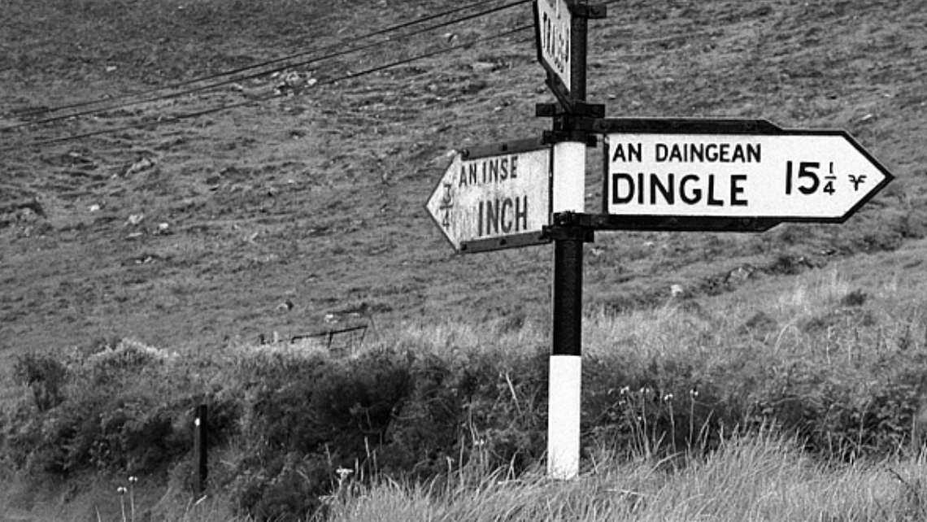

Slide 16
Evidence helps us “update”
If you start with an implausible hypothesis, you need to work harder
Replicating an experiment makes it ‘easier’ to persuade because our prior will have been shifted by the first study.
Making specific predictions helps… if there are many possible outcomes but you preselect one of them it increases the value of the evidence if it “comes good”.

Slide 17
“I wouldn’t start from here”
*this is the absolute best case and still ignores other issues
Prior probability it’s “real” | Evidence p(data|null) from the Bargh et al experiment | Posterior odds Prior*evidence | Posterior probability it’s “a real effect” | p value you would need to be 95% sure it’s “real”
50% (Odds = 1) | (1 - 0.049) / 0.049 (Odds = 19.4) | 19.4 | 95% | .05
10% (Odds = 9) |  | 2.1 | 68% | .024
5% (Odds = 19) |  | 1.02 | 51% | .002

